Slide 1


WELCOME

Slide 2
Lesson identity
Class:Five
Subject: English
Unit: Twenty one
Lesson: 1-2
It was a great day
(My name is Shuvo …….. Slept in the tent.)

Slide 3
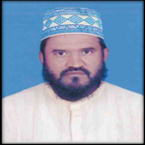
Super
Kharia Tamirul Millat Dakhil Madrsah
Shibpur, Narsingdi.
Mobil-01718-492271 email-homayonkabirsuper@gmail.com
Presented By
Md.Homayon Kabir

Slide 4

Learning outcomes
By the end of the lesson students will be able---
1.5 To read words, phrases and sentences in the text with proper pronunciation, stress and intonation.
3.1 To ask and answer Wh and Yes/No questions.
10.1 To write a short piece of composition by answering a set of questions.

Slide 5

What’s this?
It’s the logo of Cub Camporee.

Slide 6
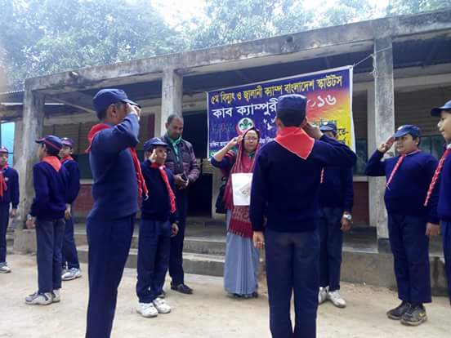
cub camporee
Last January I went to a cub camporee.

Slide 7
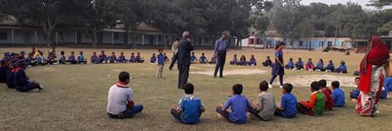
A camporee is a gathering of cubs from different parts of Bangladesh.

Slide 8
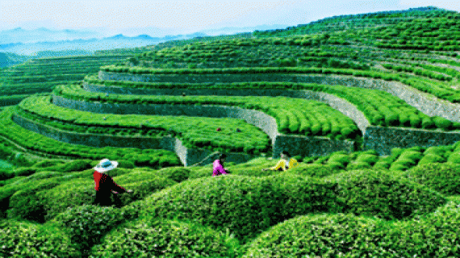
Sreemangal
Do you know the place?
The cub camporee took place in Sreemangal.

Slide 9
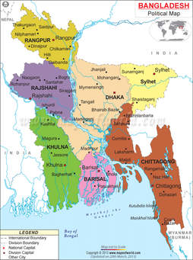
We first travelled from Dhaka to Sylhet.

Slide 10
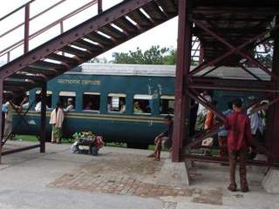
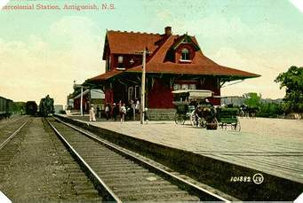
Sylhet railway station
Sreemangal
From Sylhet, We took a train to Sreemanngal.

Slide 11
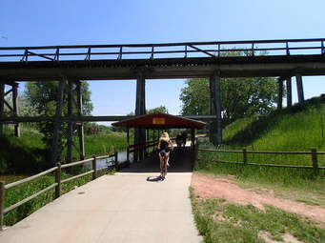

We arrived in the morning, so the weather was nice.

Slide 12
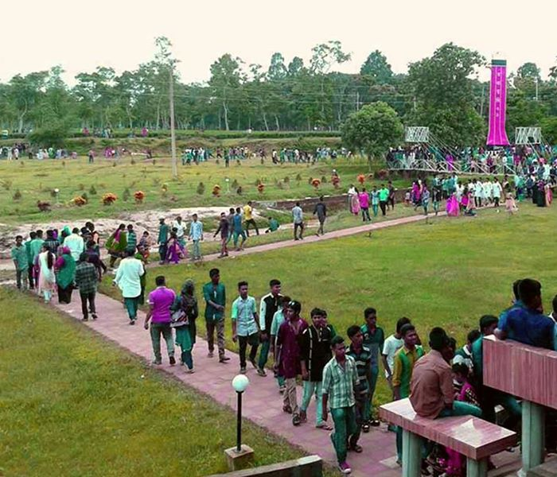
We walked to our camp from the train station.

Slide 13
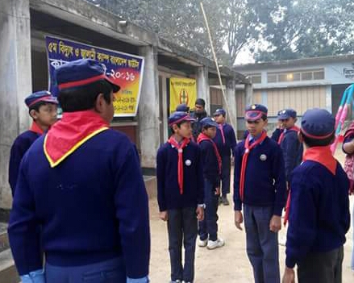
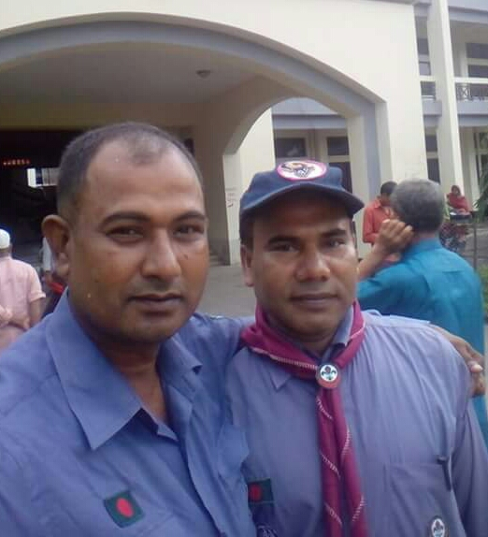
There were 10 of us
and
two leaders.

Slide 14
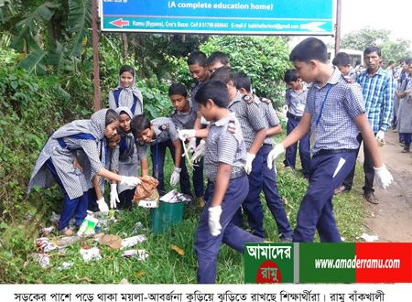
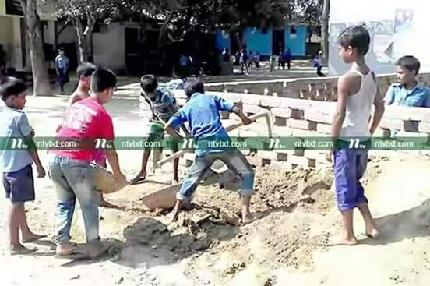
We cleaned up area.

Slide 15

Set up our tents

Slide 16
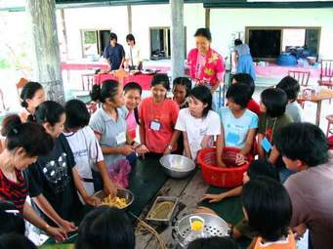
Prepared our breakfast.

Slide 17
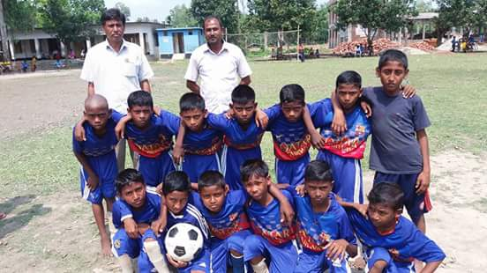
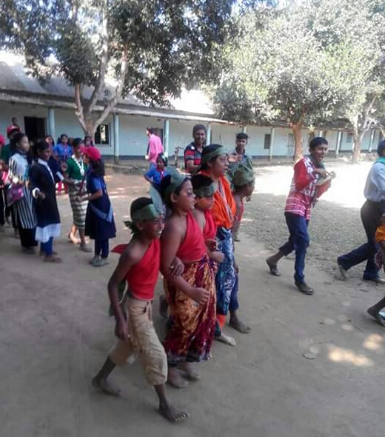
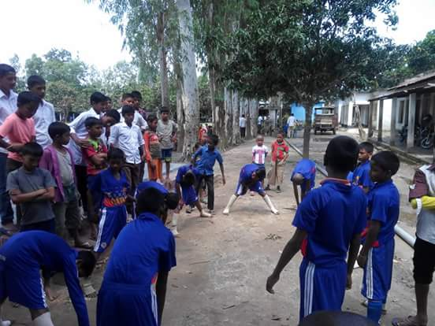
We play games with cubs from other parts of bangladesh.

Slide 18
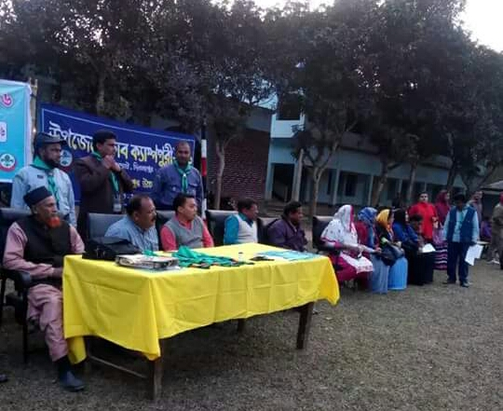
In the afternoon and evening, we sang songs and recited poems.

Slide 19
Over all
It was a great day

Slide 20
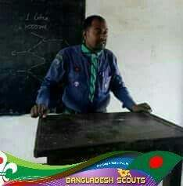
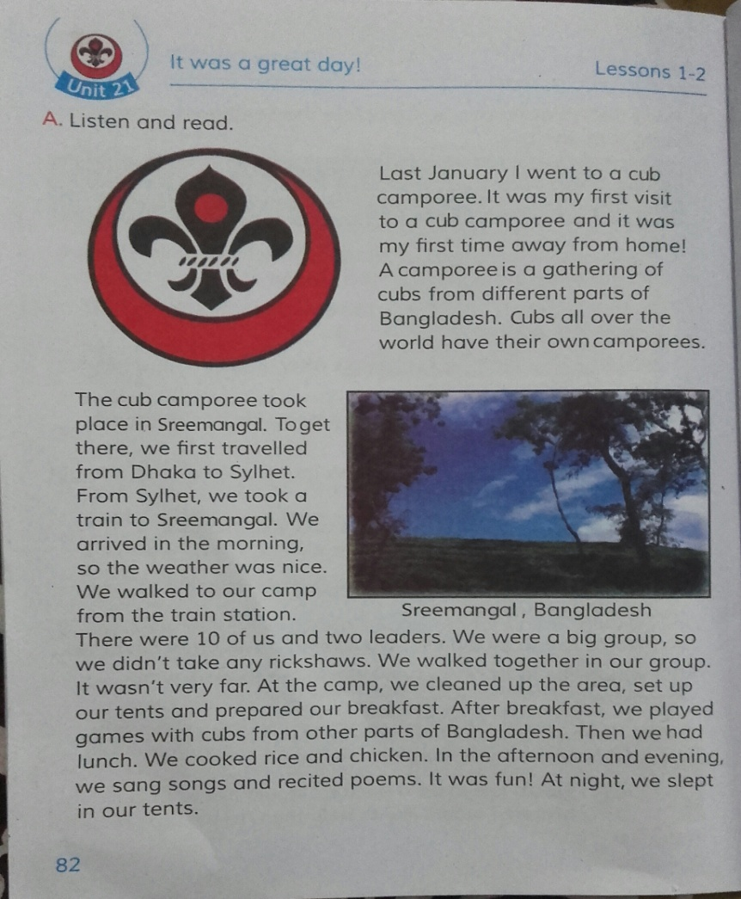
Teacher’s loud reading and discuss the lesson.

Slide 21
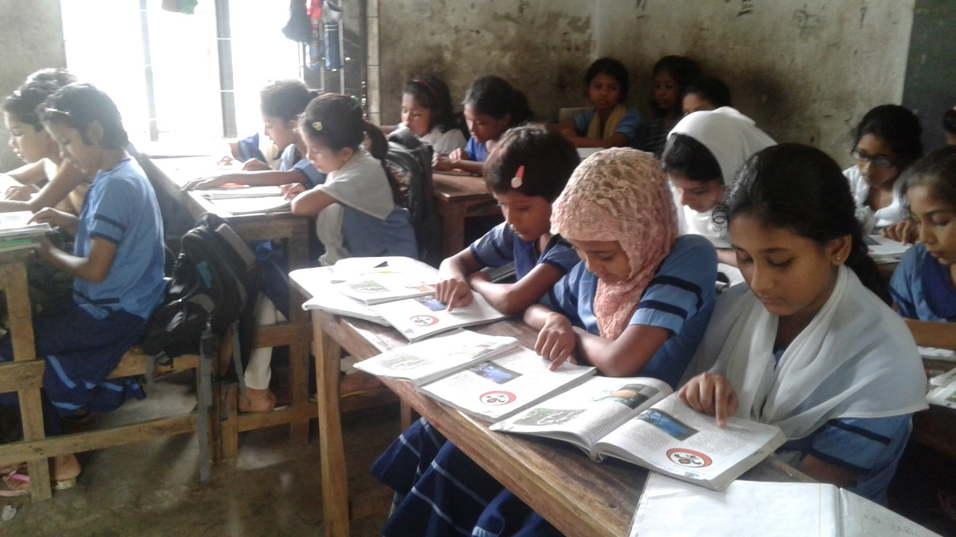
Student’s silent reading help by teacher.

Slide 22
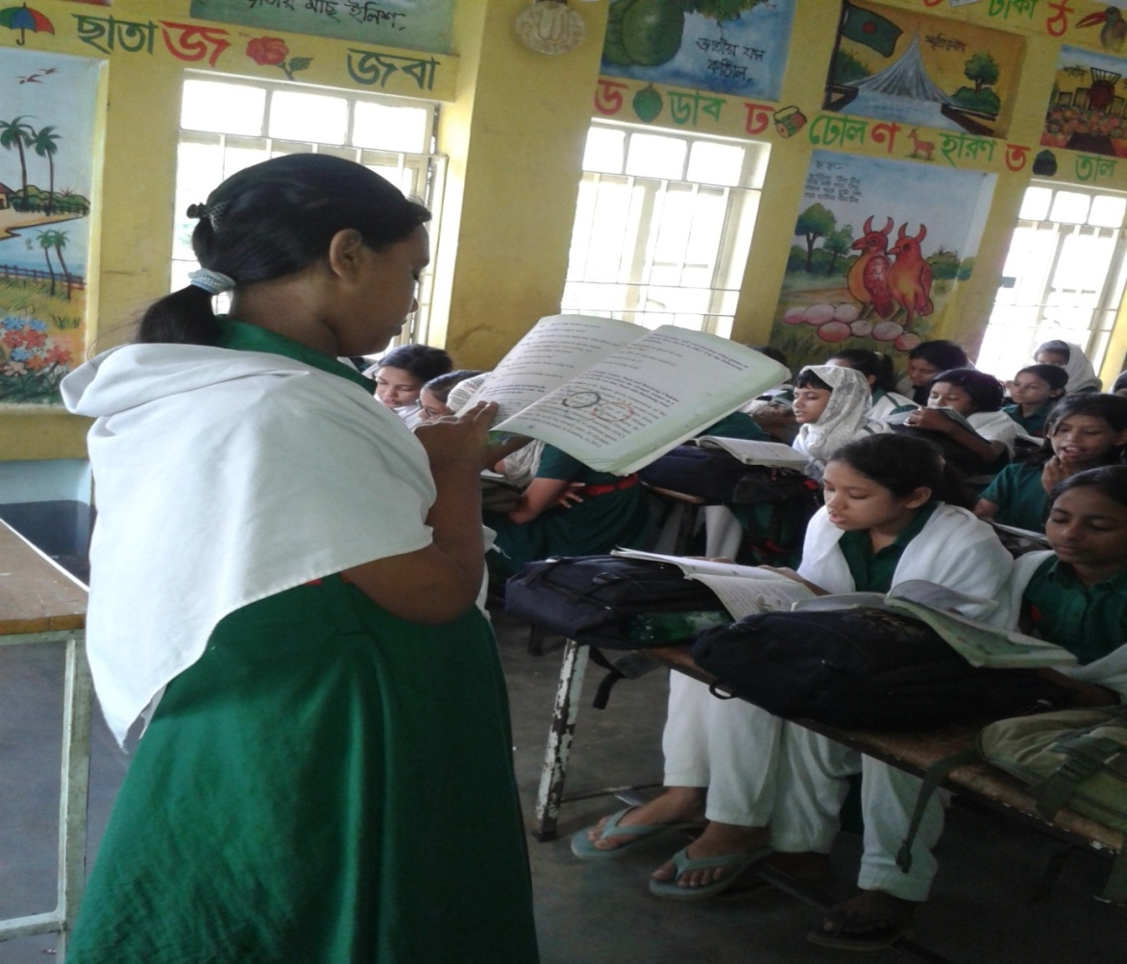
Students loud reading

Slide 23
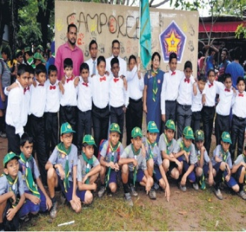
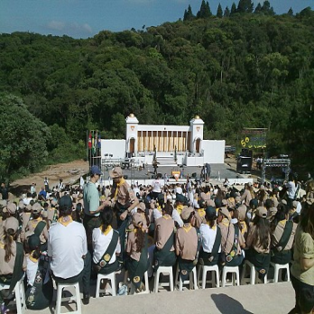
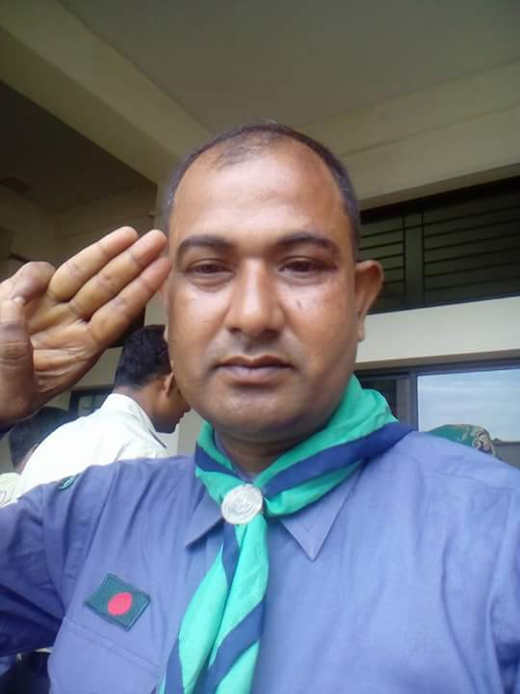
New words
camporee
gathering
leader

Slide 24
Ask and answer
Write only the answer on the answer paper
1.When did the speaker go to a cub camporee?
Ans=
Last January.
2. How many members did the team have?
Ans=
10 members
3. What did they do at first ?
Ans=
Cleaning
4.When did they reach?
Ans=
In the morning

Slide 25
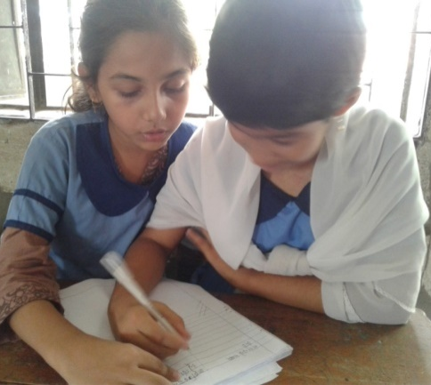
Pair work
Write a short piece of composition by answering a set of questions.
What is a cub camporee?
(b) Were did the cub camporee take place?
(c) What did you do in the morning of the first day?
(d) How did you do in the evening?
(e) How did you end your program?

Slide 26
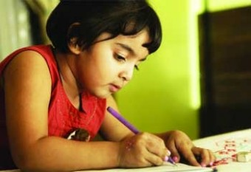

Home work
You will write five sentences about your “memorable event”.

Slide 27
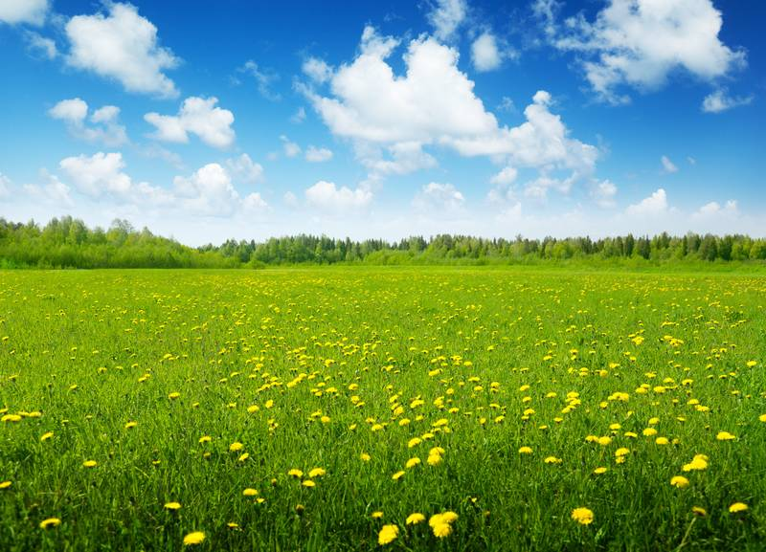
Thank you everybody
See you again.
Bye ---- Bye.

